Slide 1



Department of Computer Science and Engineering
Project Phase – II (18CSP83)
Review – 1
ENHANCING THE PERFORMANCE OF ANTIPHISHING MECHANISM USING MACHINE LEARNING
Group No.: 06 Batch No.: 2021_CSE_08
R Soumya 1KS18CS125
Sri Chandana P 1KS18CS098
Vijetha 1KS18CS117
Sushmitha S 1KS18CS106
Guided By:
Mr. Roopesh Kumar BN
Asst. Professor Dept of CSE
KSIT Bengaluru

Slide 2
Contents
Introduction
Comparison with similar work
Problem Statement and Objectives
Methodology
Technologies and tools used
Implementation of Modules with codes
Snapshots
References

Slide 3
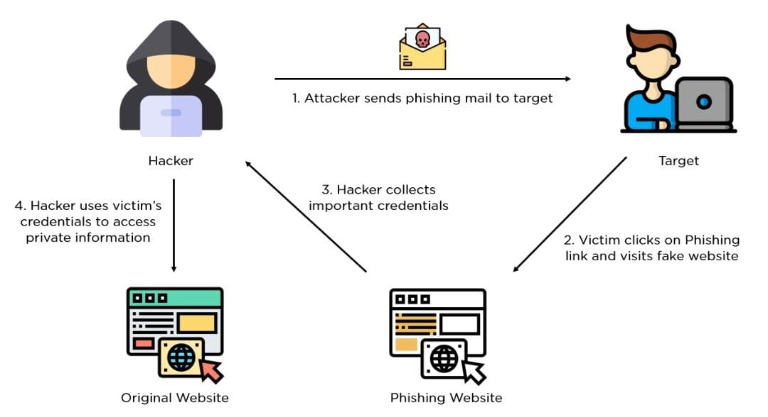
Introduction
The cyber security problems are increasing nowadays due to the growth of internet world wide one of them is phishing.
In this attacker creates a replica of existing link or webpage to fool the user to get access to the personal information.
Phishers use multiple methods, including email, uniform resource locators(URL), instant messages, forum postings, telephone calls, and text messages to steal user information.
Figure 1: Steps of Phishing

Slide 4
Introduction
The success mainly depends on recognizing phishing websites accurately and within an acceptable timescale.
The ML based phishing techniques depend on website functionalities to gather information that can help classify websites for detecting phishing sites. Here some common supervised learning techniques are applied to accurately detect phishing websites.

Slide 5
Comparison with similar work
1. Google Safe Browsing:
It uses blacklist anti-phishing technique to detect phishing .The suspicious URL is checked in the blacklist for its presence.
The limitation in this approach is that phishing sites which are not listed in blacklist are not detected.
2. Based on visual similarity:
This technique classifies the suspicious websites based on image similarity.
It can auto update the whitelist with addition of suspicious websites that are classified as neither legitimate nor phishing.
The limitation of this approach is very high false positive and high false negative rate and image comparison at client side leads to delay in browser’s experience.
Notes:
Arduino is an open-source product, software/hardware which is accessible and flexible to customers.
Arduino is flexible because of offering variety of digital and analog pins, SPI and PWM outputs.
Arduino is easy to use, connected to a computer via a USB and communicates using serial protocol.
Inexpensive, around 500 rupees per board with free authoring software.
Arduino has growing online community where lots of source code is available for use, share and post examples for others to use too. Arduino is Cross-platform, which can work on Windows, Mac or Linux platforms.
Arduino follows Simple, clear programming environment as C language.

Slide 6
Comparison with similar work
3. PhishNet:
This technique takes blacklist as input and predicts variations of each URL.
This technique also has the limitation of not detecting zero day phishing attacks.
4. SpoofGaurd:
This technique takes some phishing symptoms of suspicious website and assigned some weights to classified as phishing website otherwise as legitimate.
It has an advantage of detecting zero day phishing attack but has a limitation of high false positive rate.

Slide 7
Problem Statement and Objectives
“To design the machine learning model that enhances the performance of anti-phishing mechanism”.
OBJECTIVES
To design a model that detects the phishing websites accurately.
To prevent the identity theft of the online users.

Slide 8
Methodology
Data Acquisition
Dataset is collected from UCI and Kaggle websites.
No. of records= 11056
Training dataset size= 75% (8292)
Test dataset size= 25% (2764)

Slide 9
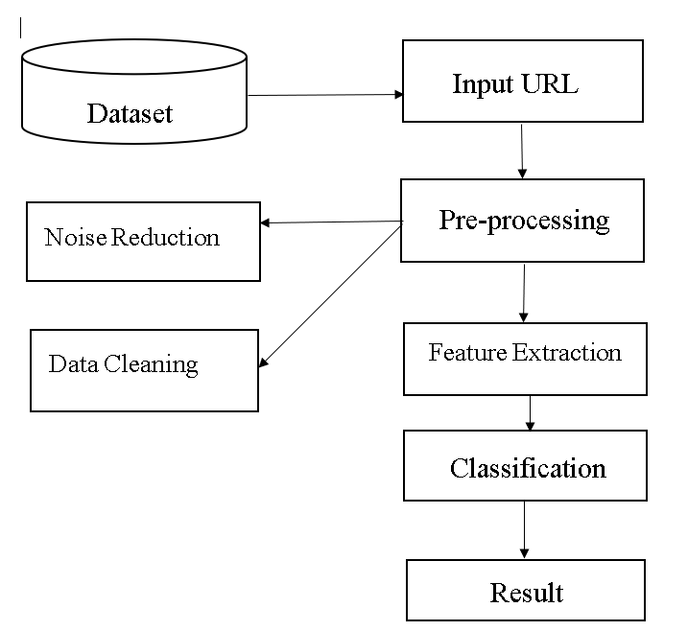
Methodology
CNN-Model
This model involves feature extraction and classification.
In feature extraction, CNN is used to extract local features.
The CNNs are used to learn sequential information from the URL.
Extracted features are converted to matrix form which is done
by the hidden layers.
We aim to get a matrix representation as
u → G ∈ R^{LxK} where gi ∈ R^{k}.
6. An instance can be depicted in the concatenation of L components
G = G1:L = g1 ⊕ g2 ⊕ ... ⊕ gL
Figure 2: Flow diagram

Slide 10
Methodology
It forms a pooling layer, these features are grouped and passed to fully connected(FC)
layers for classification purposes.
To get a more accurate result, it is combined with the LSTM model.
Accuracy and Prediction
Result of CNN-LSTM model is used in XG-Boost.
CNN-LSTM and XG-Boost will give an accuracy rate and predicts whether the input URL is phished or genuine separately.

Slide 11
Technologies and tools used
Software Requirements
Windows 7
Python
Anaconda
Libraries Used:
Numpy
Pandas
Keras
Tensorflow
Matplotlib

Slide 12
Implementation of modules with codes
Data Visualization :
plt.subplot(nrows, ncols, i+1)
plt.hist(data[var].values, bins=15)
plt.title(var, fontsize=10)
plt.tick_params(labelbottom='off', labelleft='off’)
plt.tight_layout()
plt.subplots_adjust(top=0.88)
fig.savefig('results/DataHistograms.png’)

Slide 13
Implementation of modules with codes
Feature extraction and evaluation :
x_train, x_test, y_train, y_test = train_test_split(x,y,test_size = 0.25, random_state =0 )
x_train = np.reshape(x_train, (x_train.shape[0], x_train.shape[1],1))
x_test = np.reshape(x_test, (x_test.shape[0], x_test.shape[1],1)
model = build_model([x_train.shape[0], x_train.shape[1],1])
print(model.summary())
start = timer()
hist=model.fit(x_train,y_train,batch_size=128,epochs=25,validation_split=0.2,verbose=2)
model.save('results/CNN.h5’);

Slide 14
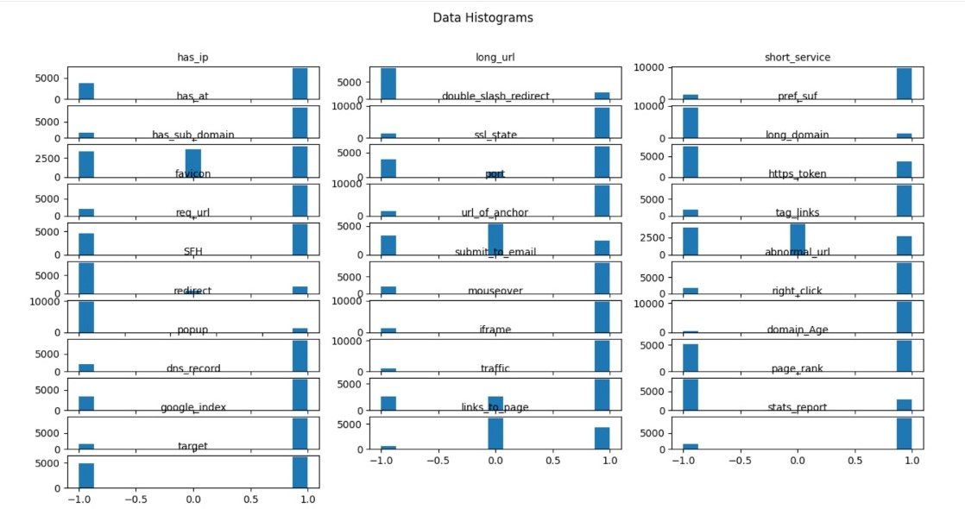
Snapshots
Figure 3: Data Visualization

Slide 15
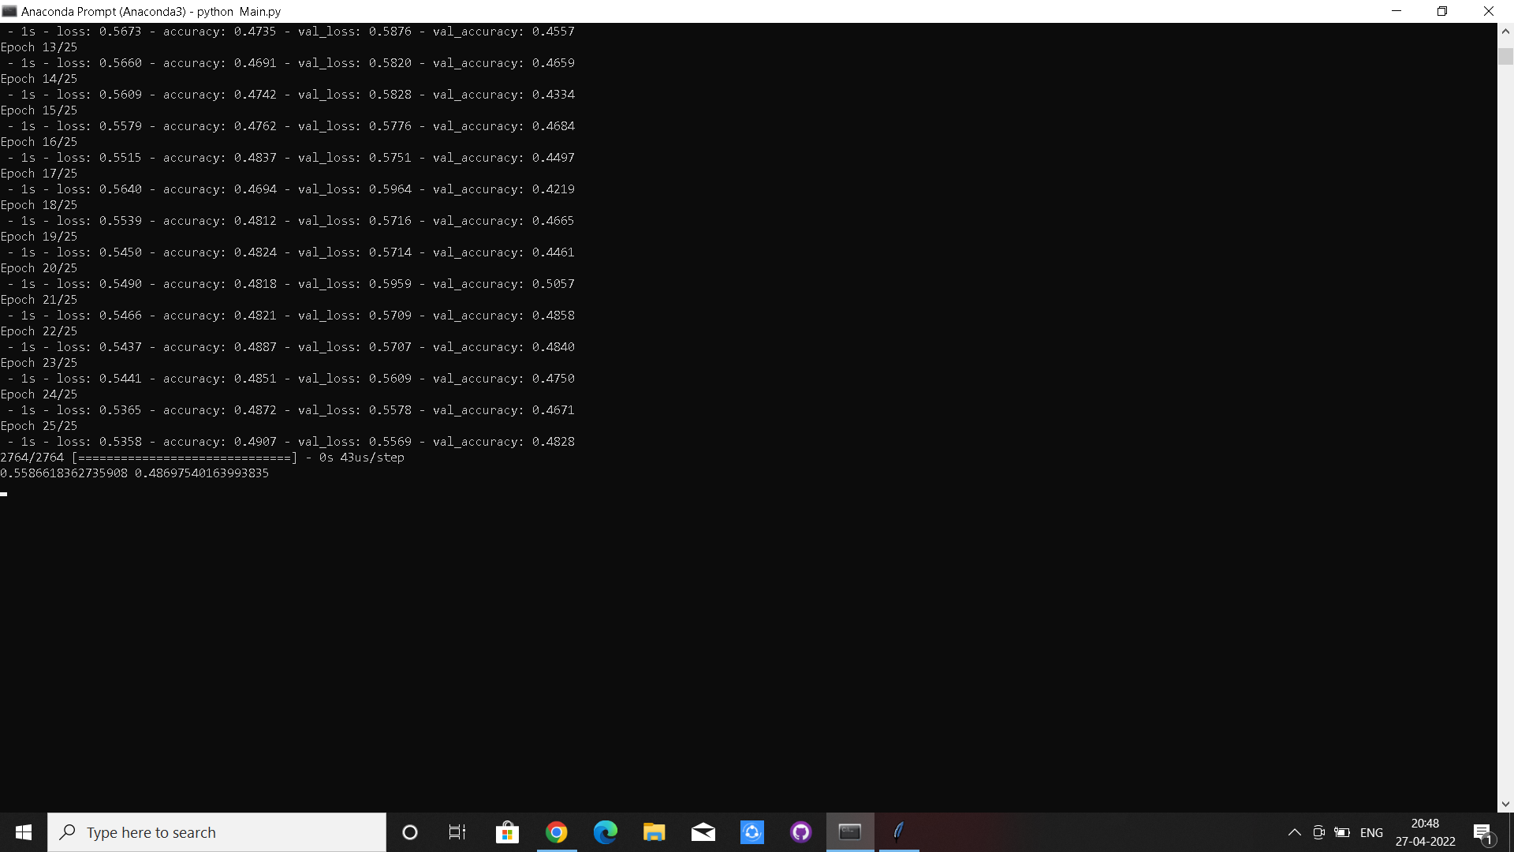
Snapshots
Figure 4: Training Epoches

Slide 16
References
[1] A S S V Lakshmi Pooja, Sridhar.M, “Analysis of Phishing Website Detection Using CNN and Bidirectional LSTM ”, in Fourth International Conference on Electronics, Communication and Aerospace Technology (ICECA-2020) IEEE Xplore Part Number: CFP20J88-ART; ISBN: 978-1-7281-6387-1, 2020.
[2] Ali Aljofey, Qingshan Jiang, Qiang Qu, Mingqing Huang, Jean-Pierre Niyigena, “An Effective Phishing Detection Model Based on Character Level Convolutional Neural Network from URL ”, in MDPI Journal, September 2020.
[3] M. A. Adebowale, K. T. Lwin, M. A. Hossain, “Deep Learning with Convolutional Neural Network and Long Short-Term Memory for Phishing Detection ”, in Conference paper IEEE, August 2019.
Notes:
Arduino is an open-source product, software/hardware which is accessible and flexible to customers.
Arduino is flexible because of offering variety of digital and analog pins, SPI and PWM outputs.
Arduino is easy to use, connected to a computer via a USB and communicates using serial protocol.
Inexpensive, around 500 rupees per board with free authoring software.
Arduino has growing online community where lots of source code is available for use, share and post examples for others to use too. Arduino is Cross-platform, which can work on Windows, Mac or Linux platforms.
Arduino follows Simple, clear programming environment as C language.

Slide 17
THANK YOU
Notes:
Arduino is an open-source product, software/hardware which is accessible and flexible to customers.
Arduino is flexible because of offering variety of digital and analog pins, SPI and PWM outputs.
Arduino is easy to use, connected to a computer via a USB and communicates using serial protocol.
Inexpensive, around 500 rupees per board with free authoring software.
Arduino has growing online community where lots of source code is available for use, share and post examples for others to use too. Arduino is Cross-platform, which can work on Windows, Mac or Linux platforms.
Arduino follows Simple, clear programming environment as C language.

